Slide 1

How are Microsoft and DevOps helping teams deliver quality results given the way the pandemic has changed how we work?
Simon Lamb
Cloud Solution Architect
@slamb2k

Slide 2
Accelerating Delivery with DevOps
Develop
“
DevOps is the union of people, process, and products to enable continuous delivery of value to your end users.
”
DevOps
Operate
Deliver
Notes:
DevOps allows us to accelerate delivery, while still delivering reliable products and services
This is about bringing people together, through shared common goals, increased collaboration and a focus on improvement
Technology plays a key role in helping to execute a DevOps strategy by enabling teams to collaborate more, enhance productivity, facilitate experimentation and automate their processes from development, through to delivery and operations
It’s also about delivering value faster by increasing efficiency, eliminating waste and streamlining feedback back to developers to continuously improve the product
The result: better products, delivered faster, to happier customers

Slide 3
Reactive operations
DEVELOP
DELIVER
OPERATE
Governance
Security
Monitoring
Automation
Resiliency
Notes:
Operations is typically an afterthought post-deployment
Operations teams usually use their own processes and tools, separate to development teams
Re-design of the application for resiliency, security and governance for an already deployed app is costly and time consuming
This means that best-effort measures are put in place to enable the application go go-live – putting the business at risk
In the event of an actual outage, this leaves little or no time to react to issues

Slide 4
Moving to proactive operations with Azure
“Shifting left”
DEVELOP
DELIVER
OPERATE
Governance
Security
Monitoring
Automation
Resiliency
Notes:
By using policy driven governance services and defining our policies in code, we can shift operations best practices “left” to early in the development cycle
We also provide developers with the tools to design apps with resiliency in mind, and providing them continuous monitoring for immediate detection and insights to application issues, in all environments from development, through to test and production.
We can now detect security vulnerabilities and risks even before deployment
And Governance policy checks and validations are applied pre-deployment, and enforced post-deployment
And because we’re now defining these operational policies as code, just as we do with our application code, with our operational code we can now take advantage of the same development, collaboration and delivery benefits using Visual Studio, GitHub and Azure DevOps.
This means less issues post-deployment, which results in less downtime and more reliable products

Slide 5


Slide 6

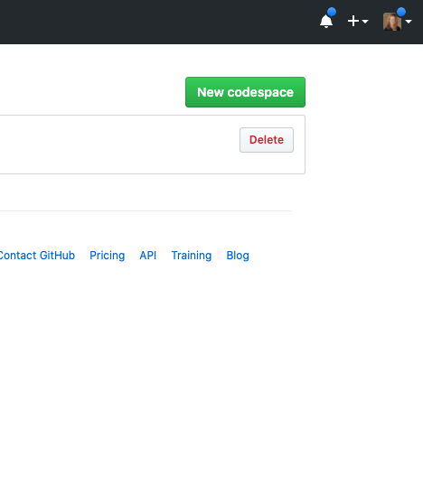
Codespaces
Your instant dev environment
Code without compromise
Code, build, test, debug, and deploy with a complete development environment in your browser.
Contribute to repos quickly
Reduce the time to set up dev environments from hours per week to a couple of minutes.
Extend and customize
Configure your editor with dotfiles and VS Code extensions to create a consistent environment in every Codespace.
Developer choice
Powered by web-based version of VS Code or, use with your desktop IDE.
https://github.com/features/codespaces
Notes:
Reducing time to set up development environments from hours per week to seconds
Powered by web-based version of VS Code, or use with your desktop IDE
Fully integrated into the GitHub developer experience
Scenarios that show the power of Codespaces:
Onboarding is much faster
Very fast to contribute to another project via Innersource. As the Bing developer who wants to contribute to a shared Office library I can just spin up a Codespaces, make my contributions in a branch, then submit a Pull Request.

Slide 7

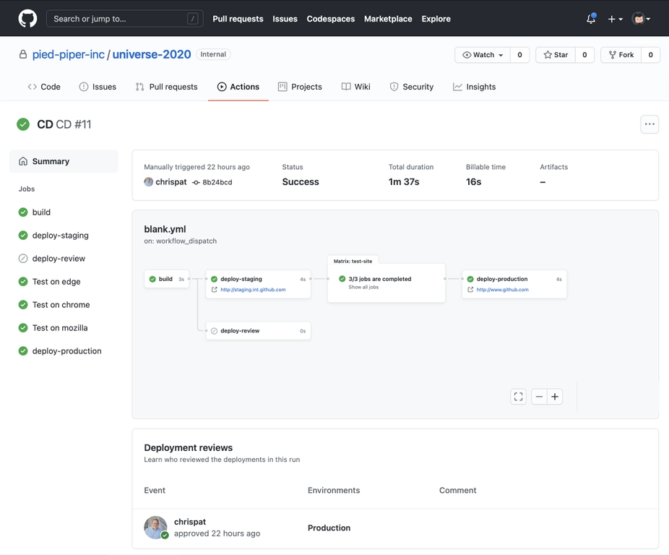
Automated Delivery
Automating workflows from code to cloud
Accelerate delivery through automation
Automation triggers for 20+ project events allows for automation beyond just CI/CD to any available API
Simple and easy to use
Configuration based on YAML with a host of sample workflows to learn from and get started
Global community for actions
Thousands of open source Actions, maintained by the community and by companies offering integrations, including Microsoft Azure
https://github.com/features/actions & New from Universe 2020: Environments, Manual Approvals and Workflow Visualization
Notes:
You can automate a lot more than just CI/CD
https://docs.microsoft.com/en-us/azure/developer/github/

Slide 8
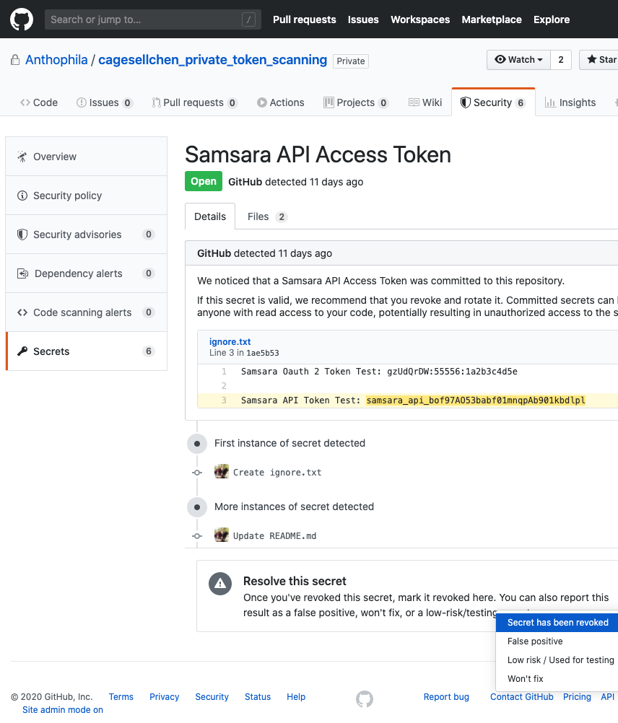
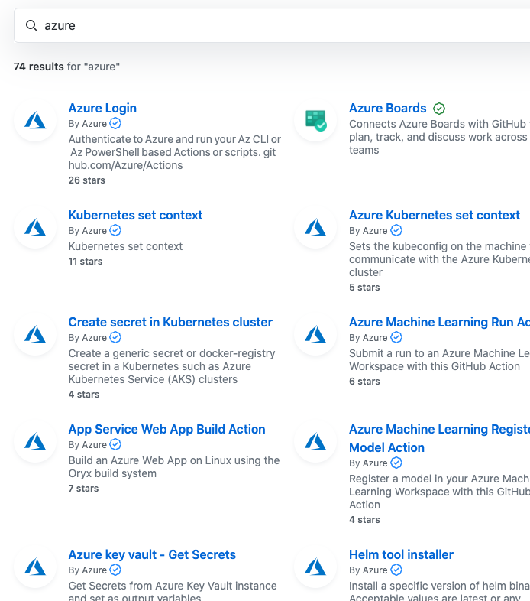
GitHub Actions for Azure Over 120 ready-to-use actions for Azure
Automate workflows:
Easily automate your code-to-cloud workflows on any GitHub event, such as code commits, creation of pull requests, or new GitHub releases. Deploy apps across popular languages and frameworks or, running on any OS.
Shift security and compliance left:
Automate governance, security, and compliance into the early stages of the software development life cycle. Write infrastructure configurations, release pipelines, compliance, and security policies “as code” to enable continuous improvement and greater transparency.
Operate seamlessly:
Shift from manual management and operation of IT environments to enable seamlessly automated IT management (GitOps) that is controllable, collaborative, and repeatable at enterprise scale.
Accelerate developer velocity:
Deploy using popular developer tools integrated with GitHub Actions. Significantly reduce ramp-up time, avoid frequent context switching, and help teams be more productive with built-in extensions into Visual Studio Code, Azure CLI, and Azure Portal.
https://azure.github.io/actions
https://github.com/marketplace?type=actions&query=Azure

Slide 9
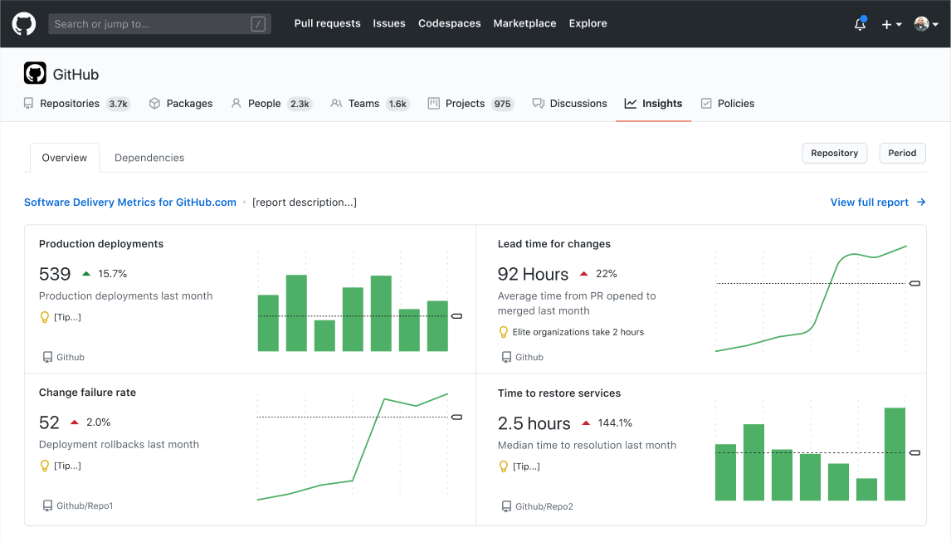
GitHub Insights
Insights provide data about your organization's activity, contributions, and dependencies.
Activity Insights
Time scoped data visualisations of repositories, including issue and pull request activity, top languages used and cumulative information about how members spend their time.
Dependency Insights
View vulnerabilities, licenses, and other important information for the open source projects your organization depends on.
Quickly access your issues and pull requests dashboard on the go.
Search GitHub for Users, Repos, Orgs, Issues, and Pull Requests. Browse results with mobile-optimized designs.
Collaborate on Issues and Pull Requests with a totally redesigned experience. Comment, react, and merge code.
“Favorite Repos” and “Recently Viewed” sections

Slide 10
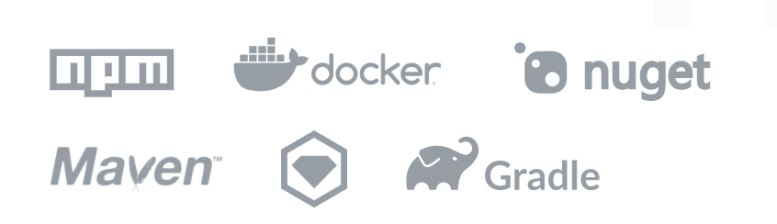
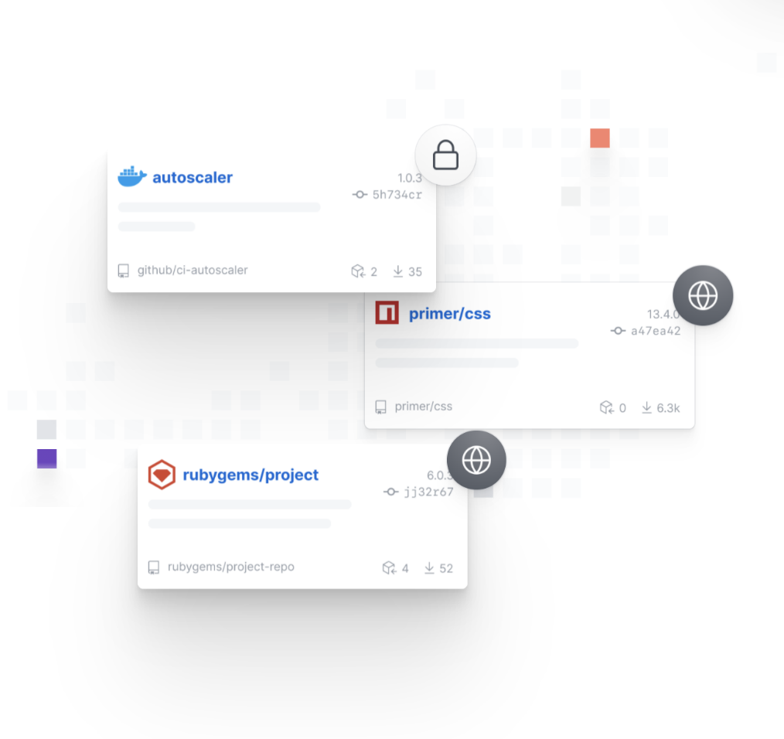
GitHub Packages
Enterprise-grade repository to securely manage dependencies`
Single, secure login for code and packages
Public and private registries, with support for multiple formats and ecosystems.
Chain of custody
Find packages on GitHub, understand details and dependencies.
Innersource and collaboration
Centralized, searchable source for approved and secure packages within your organization.
CI/CD and Dependency Management
Works seamlessly with GitHub Actions. Also works with your existing CI tool. Use as a Container Registry with Helm Charts.
https://docs.github.com/en/packages

Slide 11
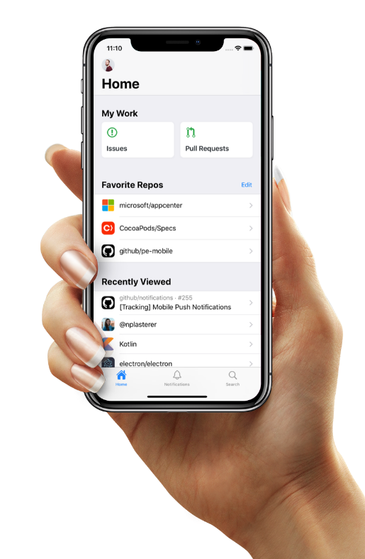
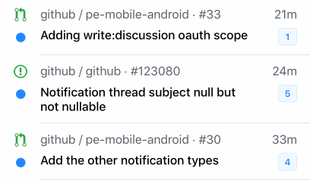
GitHub Mobile
Collaborate and develop, on-the-go
Stay connected
Stay in touch with your team and the GitHub Community, right from your mobile device
Collaborate from anywhere
Collaborate on Issues and Pull Requests with a totally redesigned experience. Comment, react, and merge code.
Breeze through your workflow
Get your inbox to zero in no time—swipe to finish a task or save the notification to return to it later.
https://github.com/mobile/
Quickly access your issues and pull requests dashboard on the go.
Search GitHub for Users, Repos, Orgs, Issues, and Pull Requests. Browse results with mobile-optimized designs.
Collaborate on Issues and Pull Requests with a totally redesigned experience. Comment, react, and merge code.
“Favorite Repos” and “Recently Viewed” sections
Notes:
Quickly access your issues and pull requests dashboard on the go.
Ensure secure access by leveraging multi-factor authentication
Search GitHub for Users, Repos, Orgs, Issues, and Pull Requests. Browse results with mobile-optimized designs.
Collaborate on Issues and Pull Requests with a totally redesigned experience. Comment, react, and merge code.
“Favorite Repos” and “Recently Viewed” sections
With GitHub mobile, you can:
Organize tasks in a swipe: Get your inbox to zero in no time—swipe to finish a task or save the notification to return to it later.
Give feedback and respond to issues: Respond to comments while you’re on the go.
Review and merge pull requests: Merge and mark pull requests to breeze through your workflow, wherever you are.

Slide 12
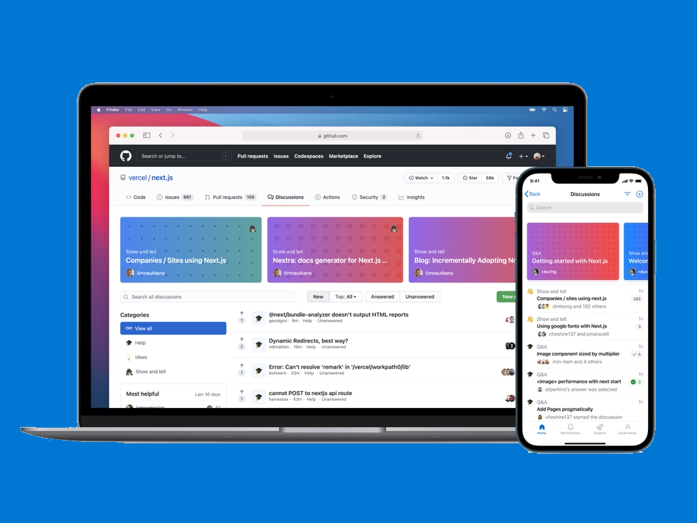
Discussions
Join the conversation
Open conversations about code and community
New threaded format makes it easy to brainstorm feature ideas, help new users get their bearings, and collaborate on software.
Perfect for Q&A
Questions can be marked as answered, so over time a community’s knowledge base grows naturally
Familiar GitHub experience
Discussions live in your project repository, so they’re accessible where your community is already working together.
https://docs.github.com/en/discussions, Example: https://github.com/github/feedback/discussions

Slide 13



















Innersource with GitHub
Enabling open source culture and best practices inside your organization
Increased collaboration
Encourage teams to collaborate within your organization using the same processes and practices as open source communities
Breaking silos
Simplified collaboration across teams, sharing of knowledge, improved code reuse, and secured workflows
Higher developer satisfaction
Leveraging inner source and open source practices increases developers’ satisfaction, enabling them to work on interesting projects and increase their skills
Notes:
GitHub is just a better platform for Innersource. Azure Repos is just not as good at discovering and sharing code across teams like Windows, Office, etc.

Slide 14

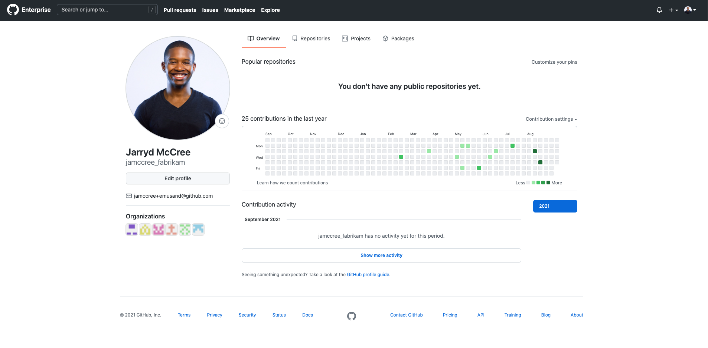
Enterprise Managed Users
Enterprise owned user accounts in the GitHub Cloud
Full lifecycle ownership of user accounts
Automated account management and team syncing with SCIM
SAML backed and fully auditable
No public repositories
Enterprise managed users are now generally available for GitHub Enterprise Cloud | The GitHub Blog

Slide 15
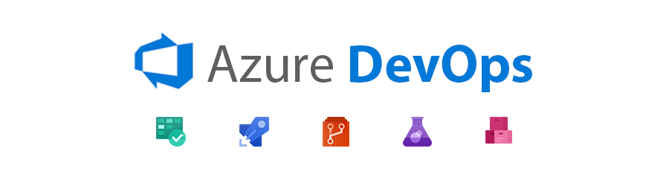

Slide 16
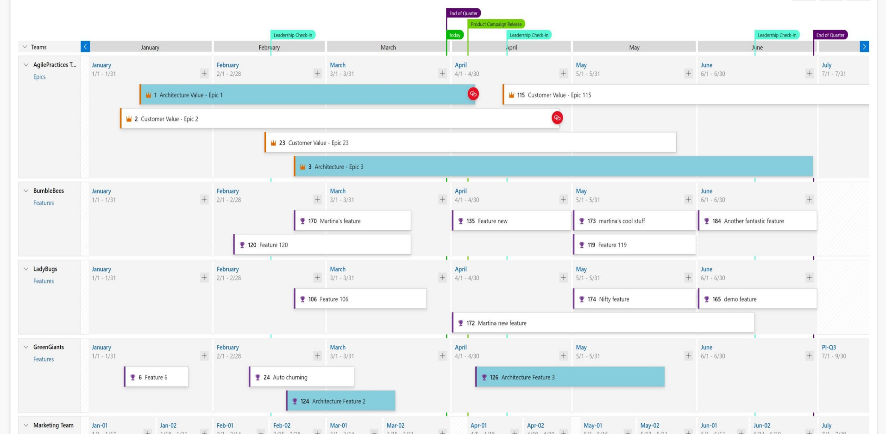
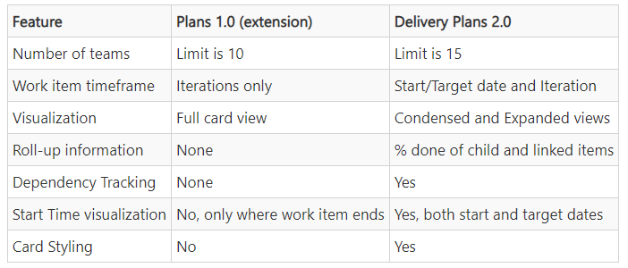
Delivery Plans
Delivery Plans 2.0 delivers on 3 key scenarios
A timeline view of the plan
Progress of the work
Dependency Tracking
Delivery Plans 2.0 is now GA!

Slide 17
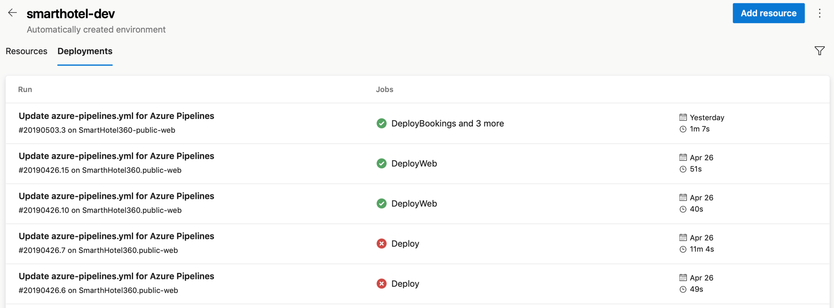
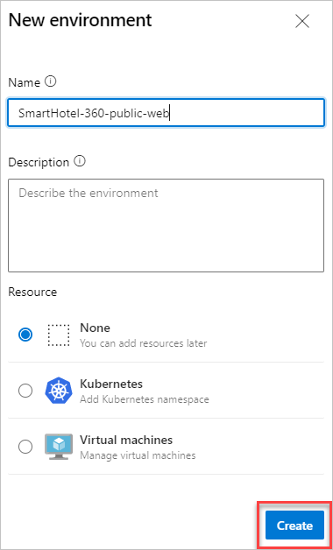
Environments
Environments are collections of resources you can target with deployments from a pipeline:
Deployment history
Traceability of commits and work items
Diagnostics resource health
Security
Create target environment - Azure Pipelines | Microsoft Docs

Slide 18
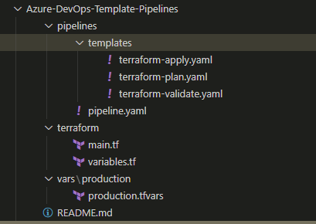
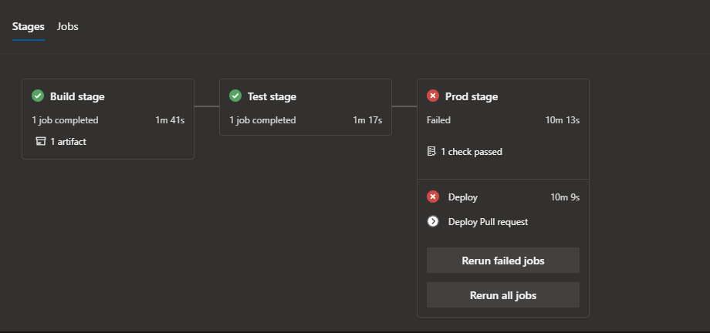
Templates
Reuse and Governance
Govern your pipelines
Ensure governance by providing control on how pipelines are built and executed.
Security
Use templates as the building blocks to focus on DevSecOps practices.
Promote reuse
Provide common patterns for provisioning resources through IaC and delivering your application.
Security through templates - Azure Pipelines | Microsoft Docs

Slide 19
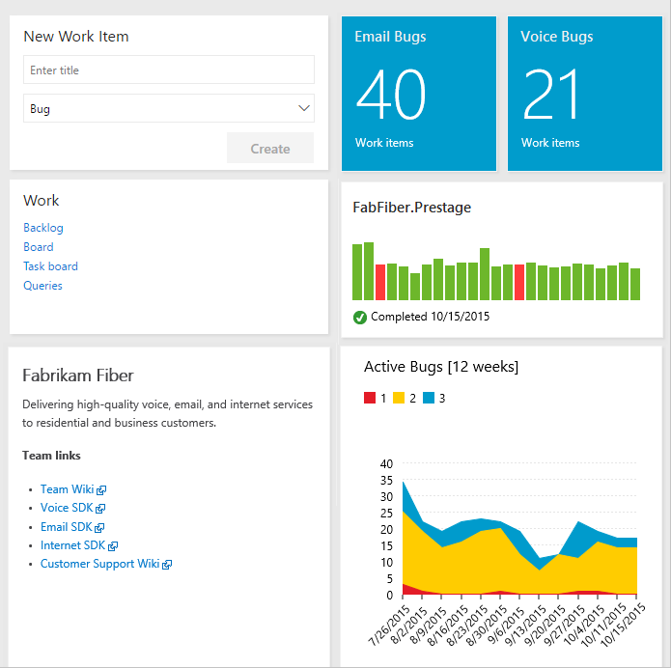
Dashboards
Gain visibility into your team's progress by adding one or more widgets or charts to your dashboard.
Dashboards
Charts
Widgets
In-context reports
Power BI reports

Slide 20
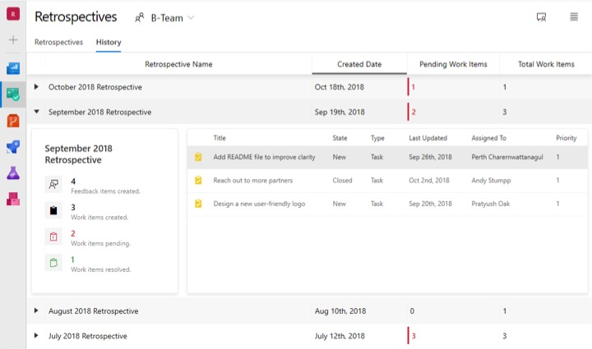
Retrospectives
Hands down the most important meeting in your sprint.
Why do we have retrospectives?
They are the basis for continual improvement.
Focus on team collaboration and diversity of ideas.
Stimulates ownership and self-management.
What should be the outcome of the retrospective?
A small list of activities or experiments to improve team performance.

Slide 21
Resources
Azure DevOps:
https://aka.ms/msbuild/AzureDevOps
DevOps at Microsoft:
https://aka.ms/msbuild/DevOpsAtMicrosoft
Azure DevOps Demo Generator:
https://aka.ms/AzureDevOpsDemo

Slide 22


Call to Action
Learn our DevOps Story (1ES)
Find out more about Microsoft’s move to cloud cadence
Find out where your partners are in their DevOps transformation
We can tailor future DevOps programs to ensure maximum benefit.
Put us in coach!!!
Feel free to reach out to the team to help with your DevOps transformation.

Slide 23
Choose your weapon…

Slide 24

Thank You
Simon Lamb
Cloud Solution Architect
@slamb2k

Slide 25
SaaS & Digital Business Enablement Journey
The Fast Path – Interim Guidance
EVALUATE
GET
STARTED
BUILD
DEPLOY +
PUBLISH
GROW
MUST
HAVES
Azure Fundamentals Learning Paths
Start DevOps Engineer Expert Certification
Microsoft Certified: Azure Administrator Associate or
Microsoft Certified: Azure Developer Associate
Complete DevOps Engineer Expert Certification
Microsoft Certified: DevOps Engineer Expert
Build great solutions with the Azure Well-Architected Framework
Creating an Azure Support Request
Monitoring usage and availability
Manage Security Operations
Get Marketplace Transactable
Develop apps for Teams
Build Dynamics 365 Finance & Ops apps
BONUS
Free Technical Cloud Training Events | Australia
Microsoft Partner Skills Hub | Australia (incl. Azure Admin & Dev Associate bootcamps)
Create your own learning path on Microsoft Learn
Introduction to the Microsoft Azure Well-Architected Framework
Create cloud native apps with Azure and open-source software
Build great solutions with the Microsoft Azure Well-Architected Framework – Learn
Develop apps with the Microsoft Graph Toolkit
Publishing Consultation (5 hours) - Advisory hours to help with Marketplace Publishing
Cloud-native security operations with Azure Sentinel
Implement Microsoft Identity
Create apps, chatbots, flows and more with Microsoft Dataverse & Teams
Get started with development in Microsoft Dynamics 365 Business Central
Notes:
There’s so many learning paths and options, where do you start?
Our lead SaaS architects at Microsoft have prepare this fast-path journey specifically for SaaS & Digital Businesses. It captures all the must have foundational skills you’ll need to successfully deploy and operate SaaS in the cloud
It also provides some additional learning paths

Slide 26
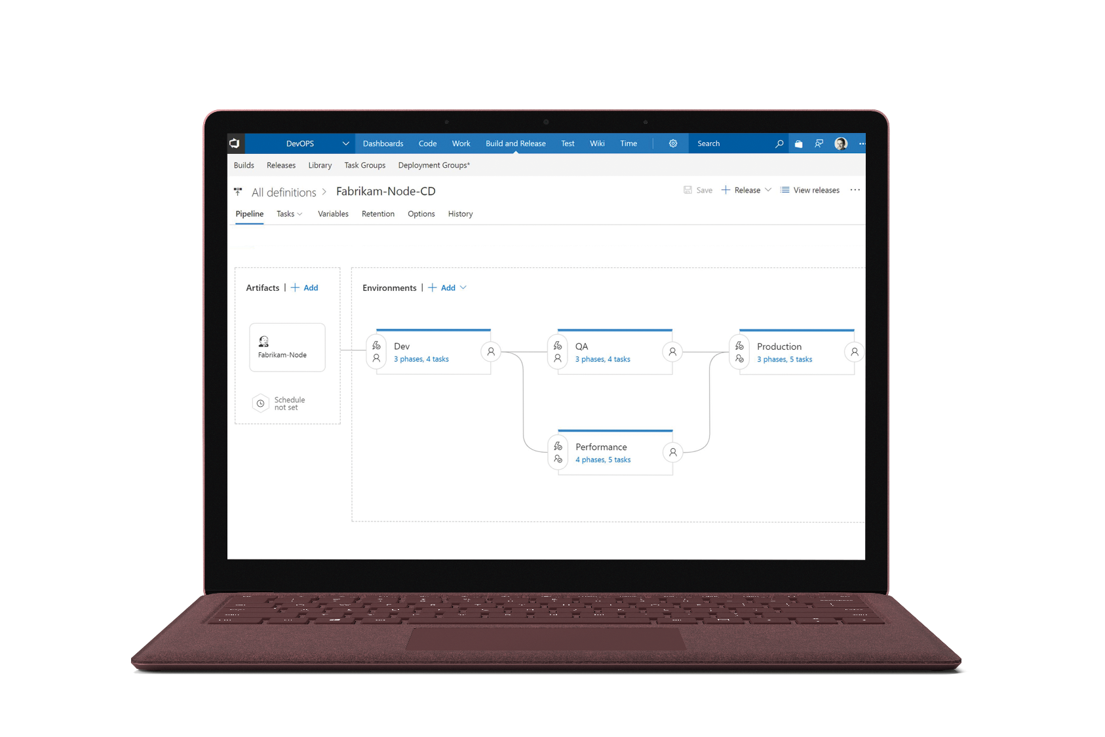
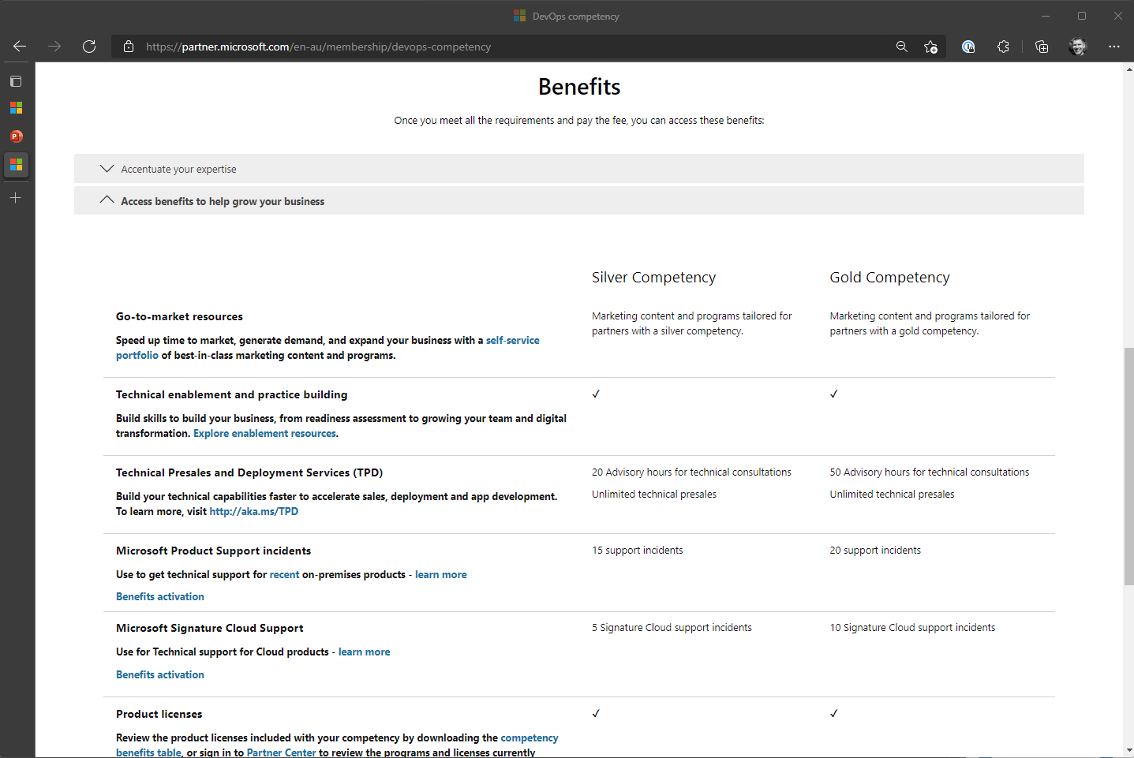
Release often. Release safely.
Future Ready the growth of your SaaS business​ & your team’s potential by attaining the DevOps Partner Competency
Silver – 2 DevOps Engineer Experts + $2200 fee
Gold – 4 DevOps Engineer Experts + $5000 fee
Gain access to:
Go-to-market resources
Technical Enablement and practice building
Technical Presales and Deployment Services
Microsoft Product Support Incidents
Microsoft Signature Cloud Support
Product licenses…
Notes:
This is about equipping your team with the right enablement and certification that can guarantee their success and potential in deploying and running SaaS solutions to Azure.
This isn’t about certifying capability with Azure DevOps or GitHub, this is about continuously delivering and operating software on Azure – core to your business. Release often. Release safely.
This is about equipping your team with the right level of Azure technical skills and implementation knowledge. As well as covering fundamental skills and technical knowledge in either the Admin or Developer certifications, this sets you up so you can successfully achieve the following on Azure:
Develop an instrumentation strategy
Develop a Site Reliability Engineering (SRE) strategy
Develop a security and compliance plan
Manage source control
Facilitate communication and collaboration
Define and implement continuous integration
Define and implement a continuous delivery and release management strategy

Slide 27
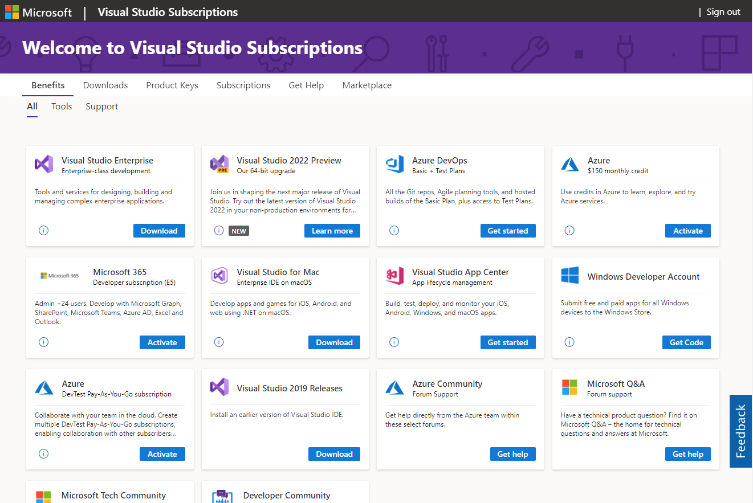
Release often. Release safely.
Continue to learn, experiment, and innovate with the Visual Studio Enterprise subscription ($9564 value each) included with your competency benefits.
Silver – 5 Visual Studio Enterprise subscriptions
Gold – 25 Visual Studio Enterprise subscriptions
Gain access to:
Visual Studio Enterprise IDE
Azure Credit $150 per month
Training and support
Azure DevOps (Basic + Test Plan)
Dev/Test Software and more….
Notes:
This is about equipping your team with the right enablement and certification that can guarantee their success and potential in deploying and running SaaS solutions to Azure.
This isn’t about certifying capability with Azure DevOps or GitHub, this is about continuously delivering and operating software on Azure – core to your business. Release often. Release safely.
This is about equipping your team with the right level of Azure technical skills and implementation knowledge. As well as covering fundamental skills and technical knowledge in either the Admin or Developer certifications, this sets you up so you can successfully achieve the following on Azure:
Develop an instrumentation strategy
Develop a Site Reliability Engineering (SRE) strategy
Develop a security and compliance plan
Manage source control
Facilitate communication and collaboration
Define and implement continuous integration
Define and implement a continuous delivery and release management strategy

Slide 28
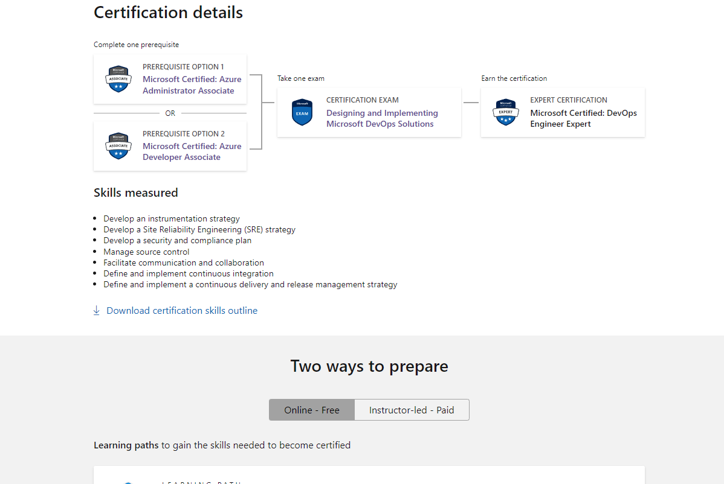
How to attain DevOps Expert
Get either your Azure Administrator Associate or Azure Developer Associate certifications, and then complete your DevOps Engineer Expert Certification.
Two ways to prepare:
Online (Free) – Microsoft Learn
Instructor-led (Paid) – Microsoft run subsidised bootcamps for partners most quarters: Microsoft Partner Skills Hub | Australia
Notes:
You’ll need to attain 2 certifications to complete DevOps Engineer Expert certification. Get either your Azure Administrator Associate or Azure Developer Associate certifications, and then complete your DevOps Engineer Expert Certification.
There’s two main ways to prepare:
Online (Free) – Microsoft Learn
Instructor-led (paid) – Microsoft run subsidized bootcamps for partners most quarters, typically for the Admin/Developer certs but also the DevOps Expert bootcamp as well depending on demand. This training is heavily subsidized and typically includes an exam voucher as a part of the cost. In

